Slide 1






Fortresses in Azure simplified:
Using Network Security Perimeter
Wesley Noordam
Azure Developer, Consultant

Slide 2




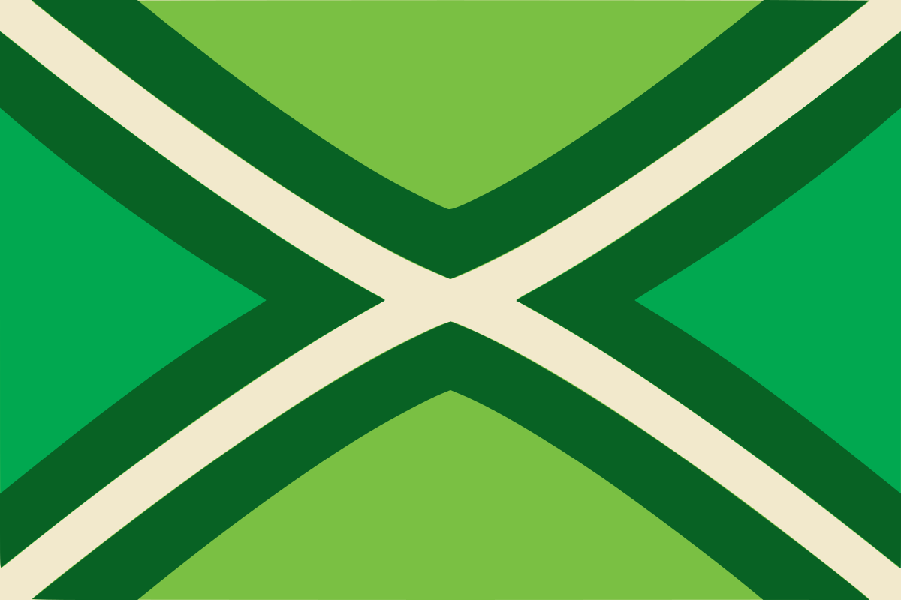
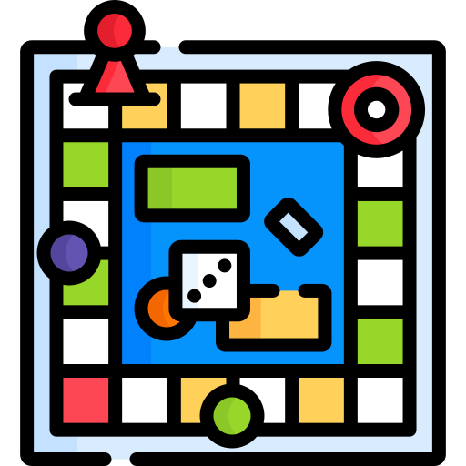

Wesley Noordam
Azure developer, consultant at XPRTZ.cloud
Wesley Noordam
wesleynoordam
Notes:
Working as Azure developer and consultant at XPRTZ.cloud and having done multiple assignments for companies like PGGM, a.s.r, ABN AMRO Mortgage and RGF.

Slide 3
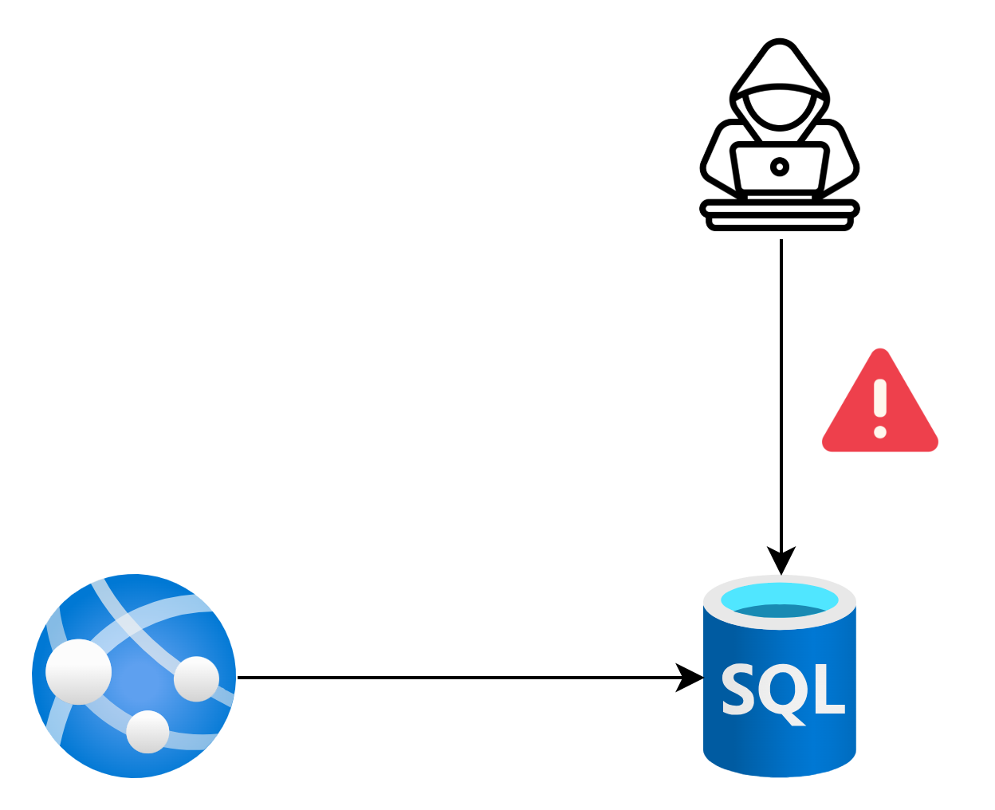
Why networking?
Keep people and applications out

Slide 4
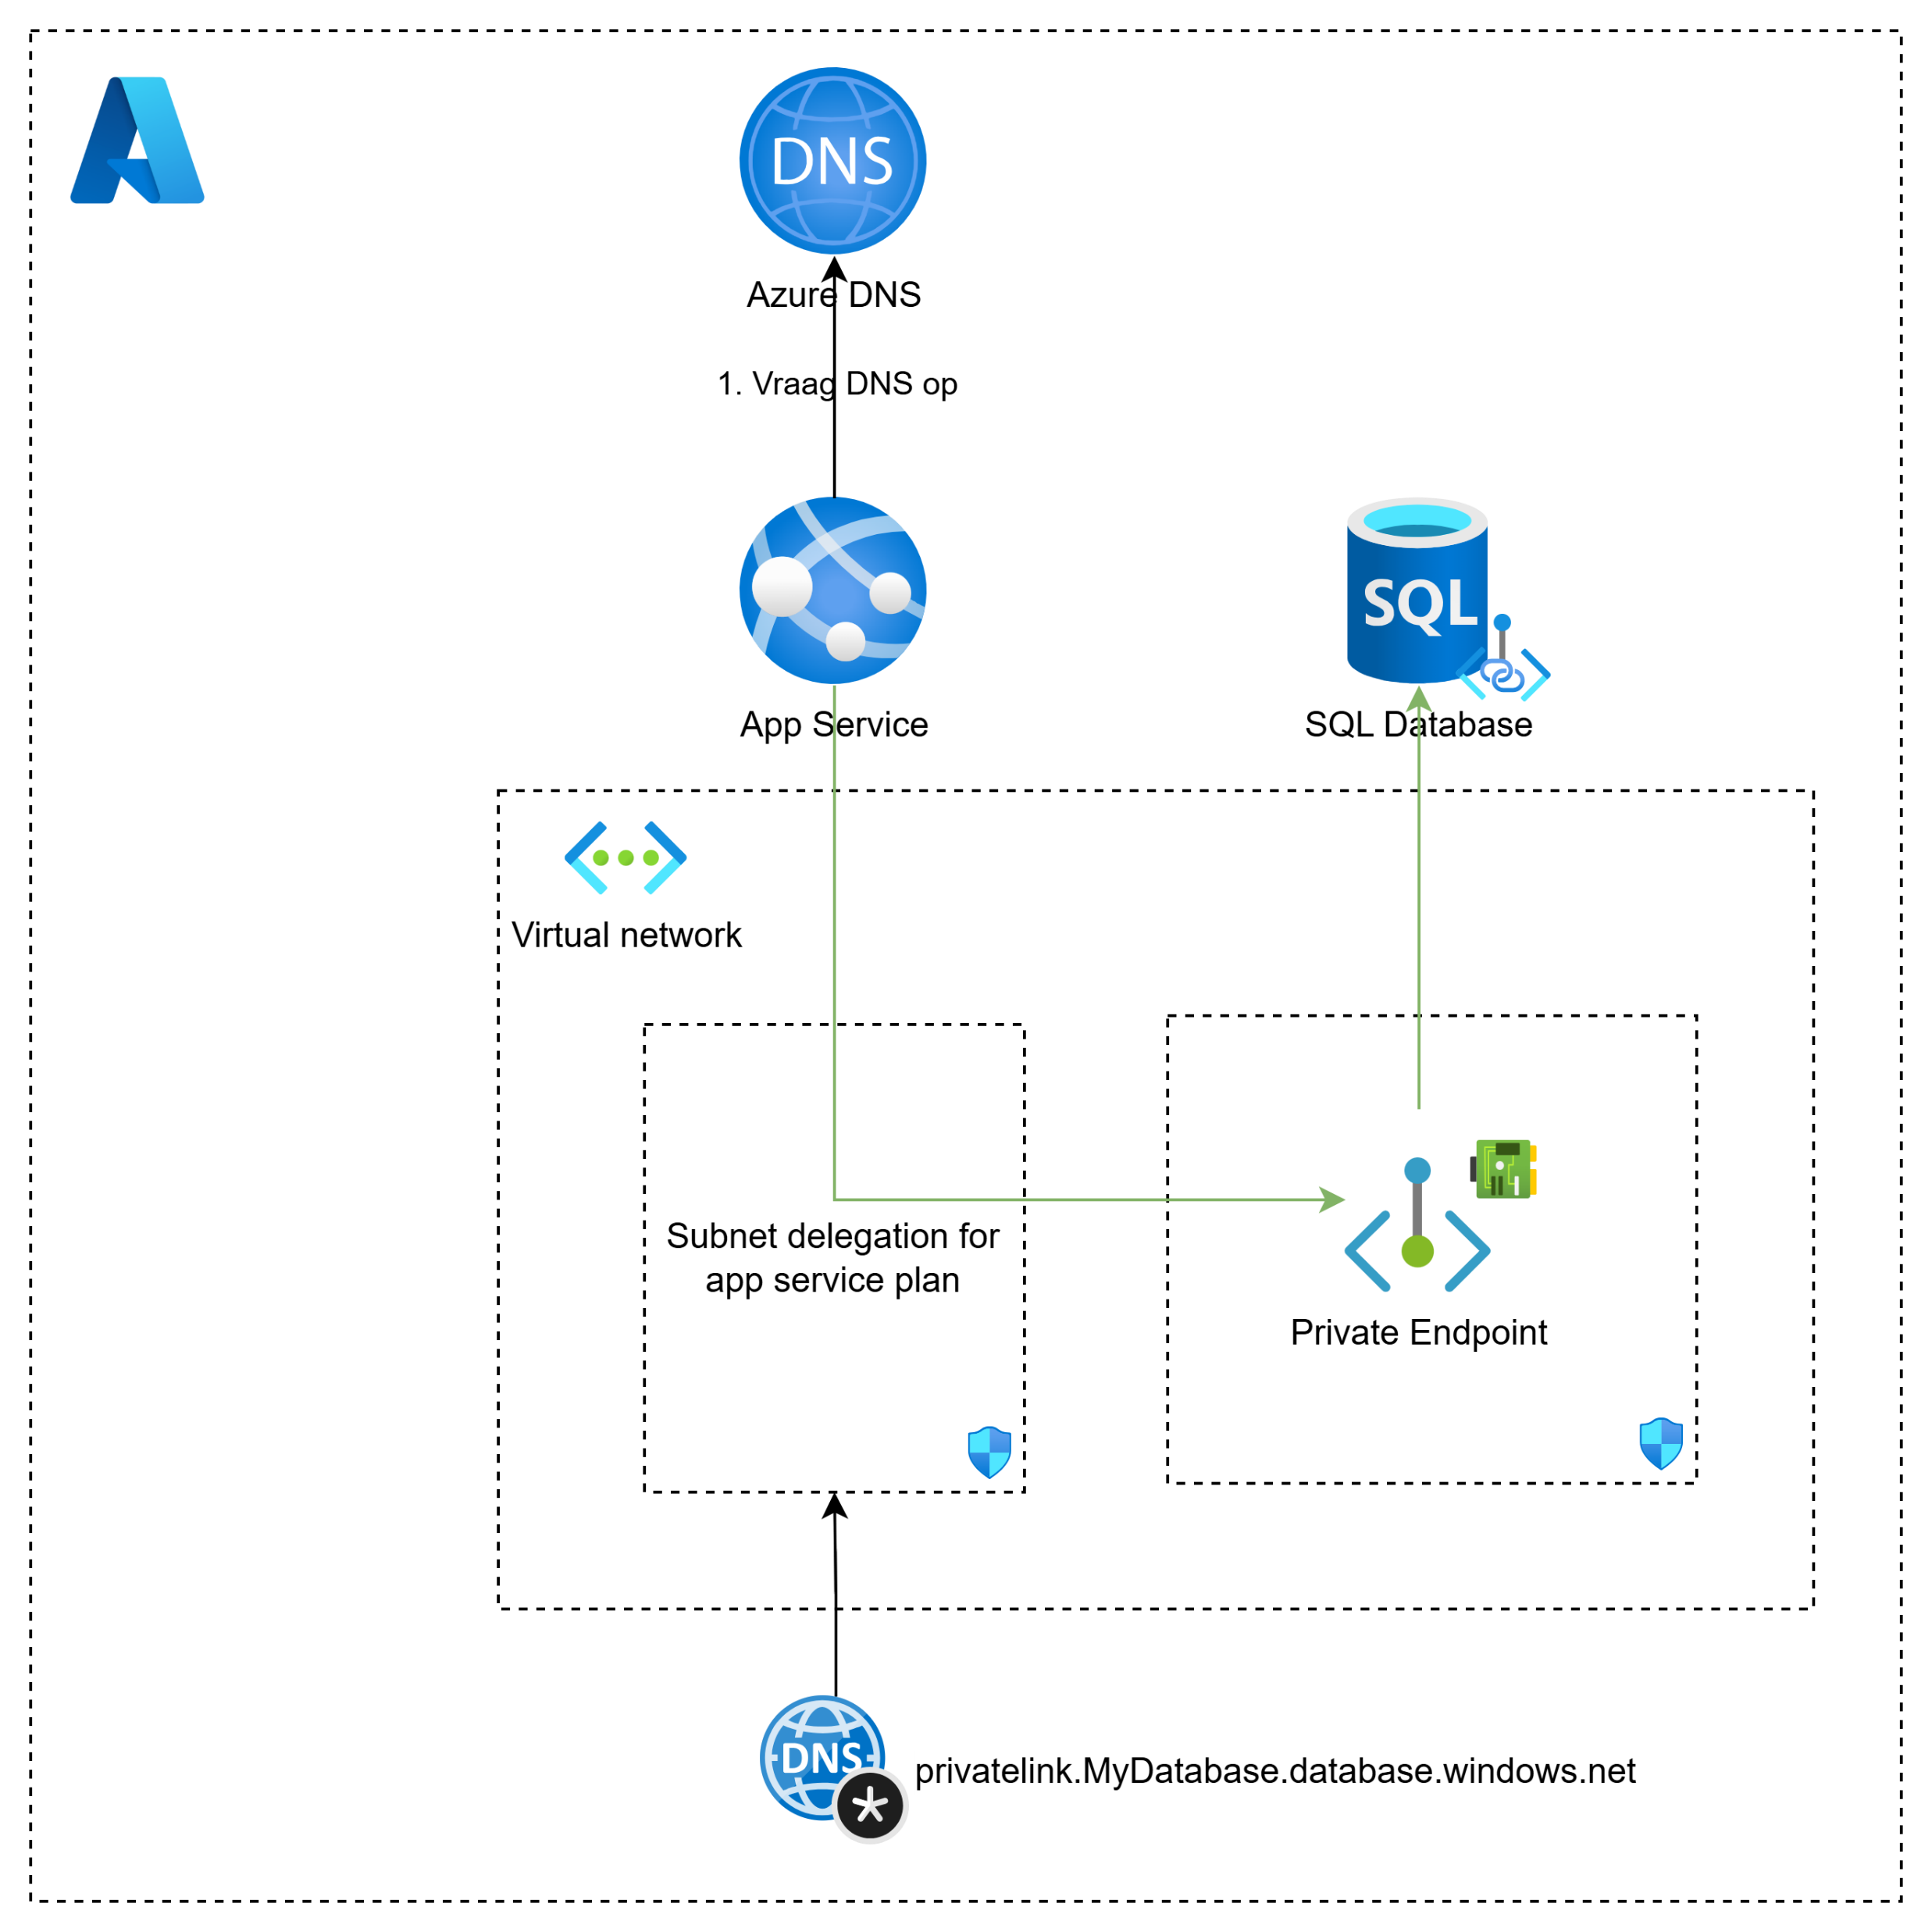
Building the (traditional) fortress
Components
Virtual Network
Private Endpoint
Network Interface
Private DNS Zone
Network Security Group (2x)
Lots of components = complex*
*From (my) developer perspective

Slide 5
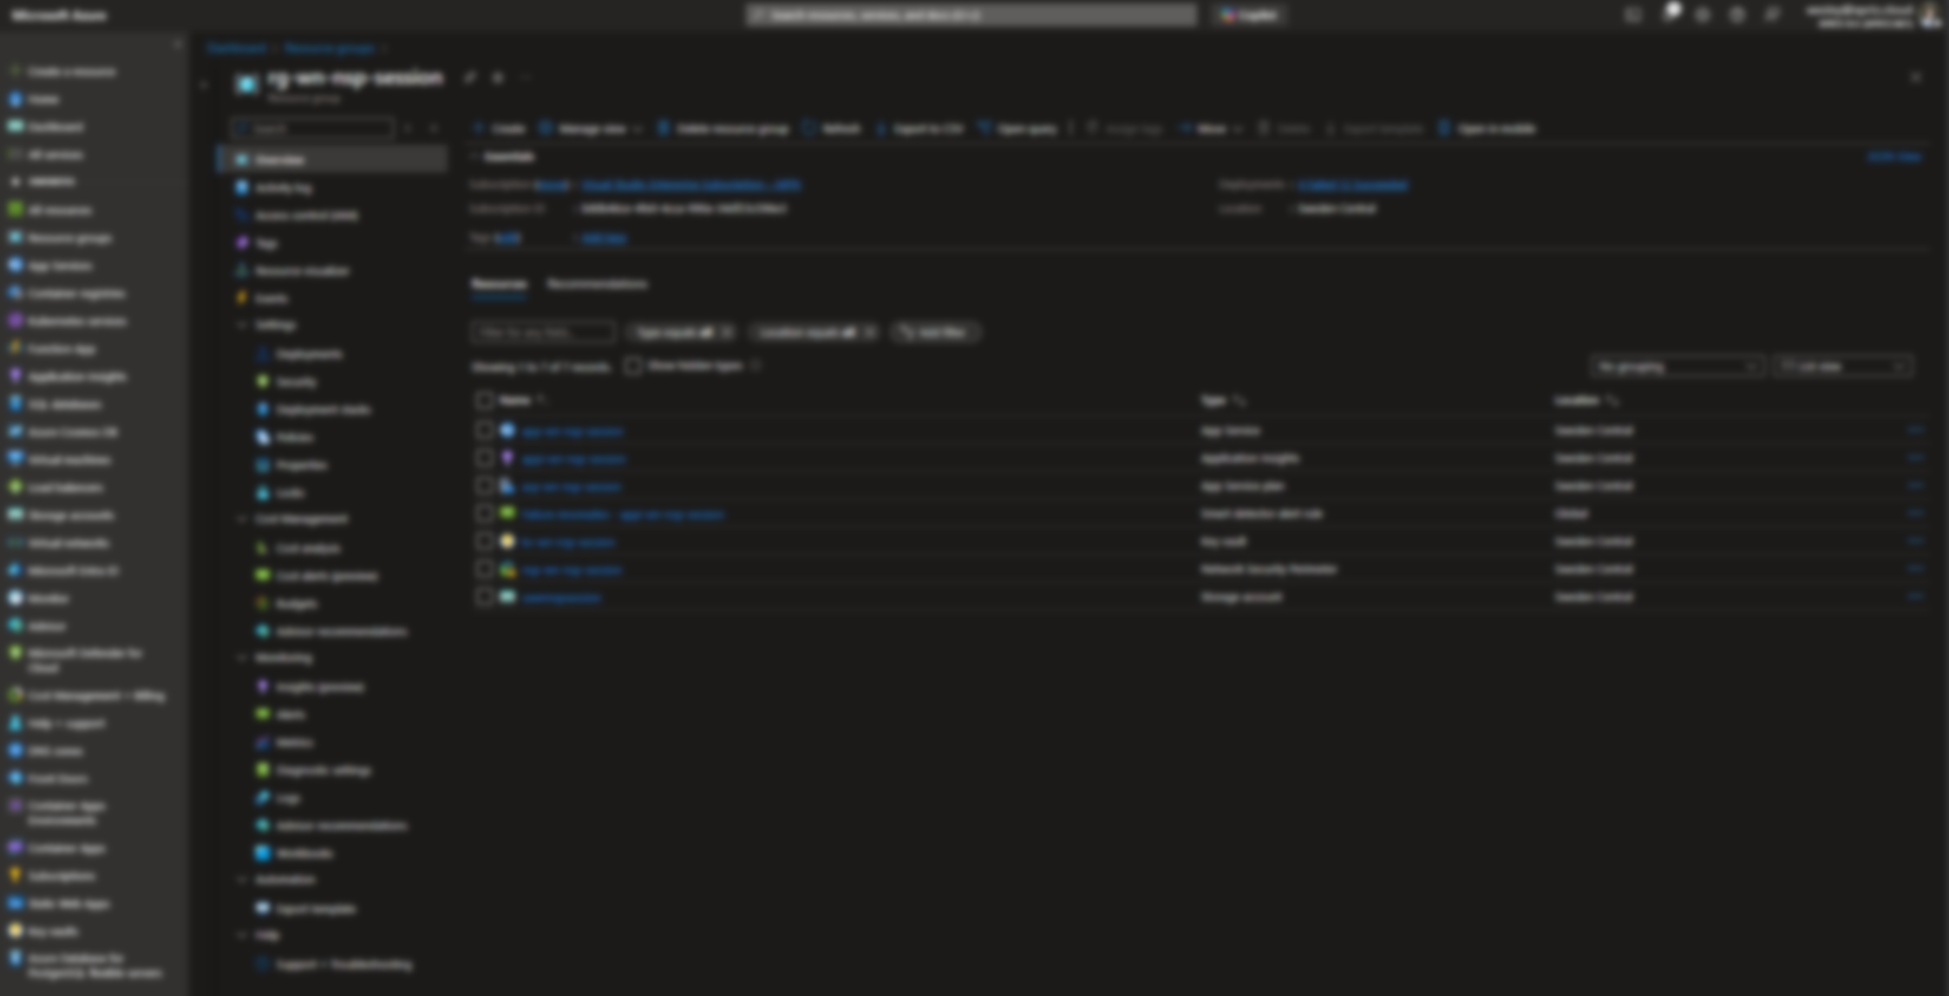

Slide 6
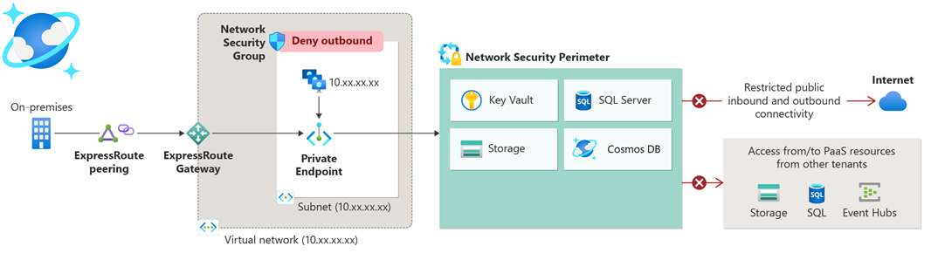
Network Security Perimeter

Slide 7
Network Security Perimeter
Features:
Analyse traffic
Uniform resource inbound and outbound management
Isolation of:
Azure Monitor
Azure AI Search
Cosmos DB
Event Hub
Key Vault
SQL DB
Storage Account
Notes:
Access logs for audit and compliance

Slide 9
VNET vs NSP
VNET
Complex
Versatile
NSP
Simplistic
Limited
Easy traffic analysis
Preview

Slide 10

github.com/wesleynoordam
wesley@xprtz.cloud
Wesley Noordam

